Slide 1
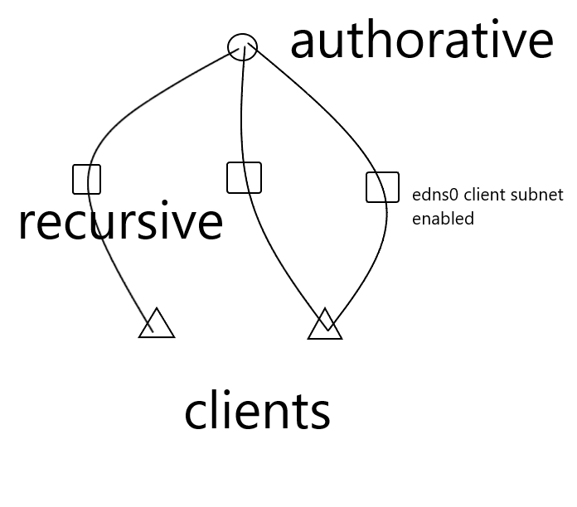
Team 2
EDNS0 mapping of botnet
RFC7871 - Client Subnet in DNS Queries
Recursors
Google
OpenDNS
Authorative
AWS
CloudFlare
Tencent
RIPE Atlas to generate requests
Packet dump profiling and visualization

Slide 2
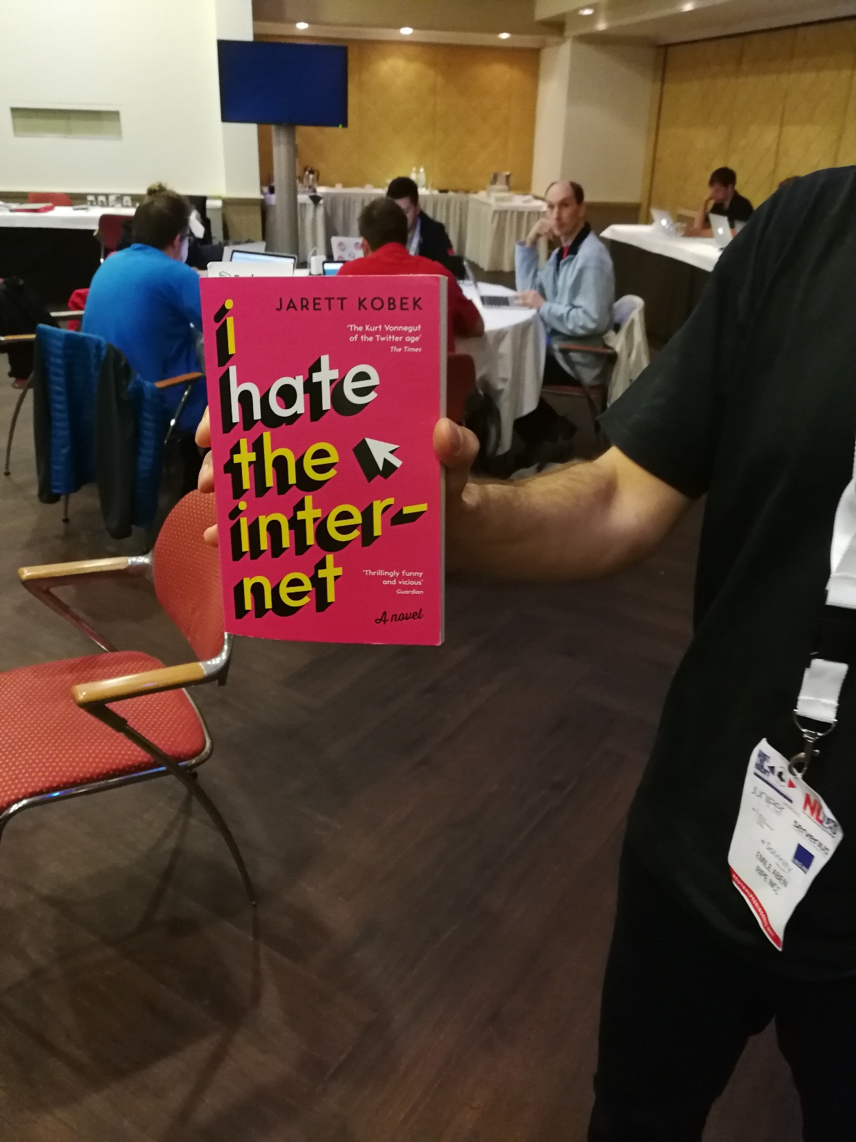
Team 2
Helps mapping botnets
Can give insight in what kind of networks bots are present
Possible flaws
Spoofing
Botnet usually does not make use of this due to NAT in home environments

